Slide 1
19CSE303-Introduction to Embedded System
School of Computing
Amrita Vishwa Vidyapeetham

Slide 2
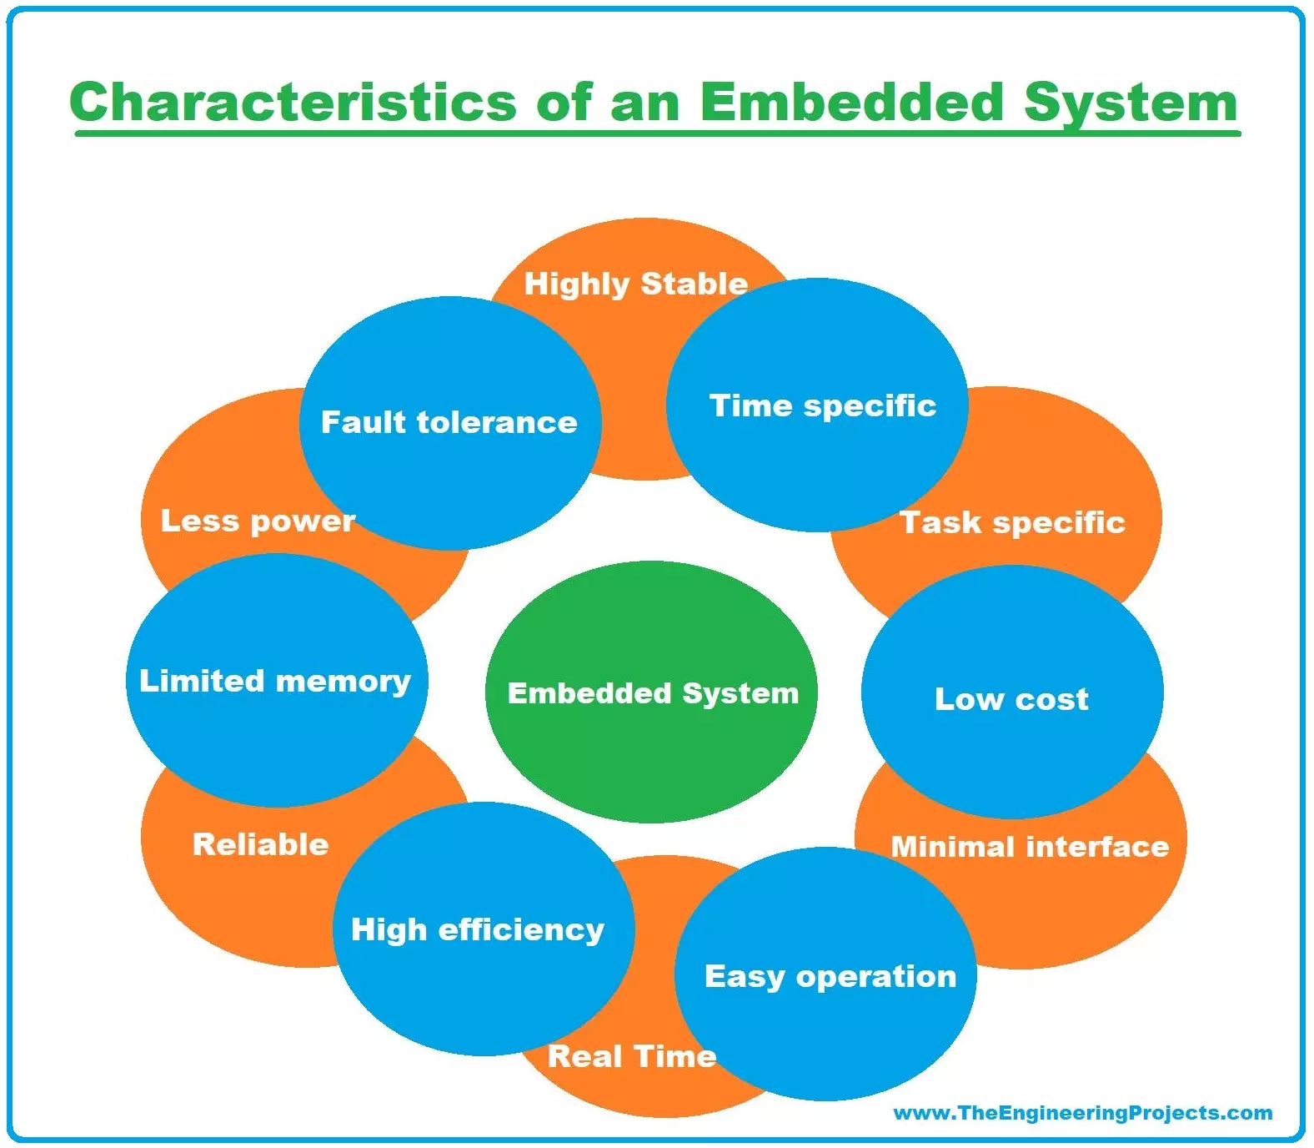
Characteristics of Embedded Systems

Slide 3
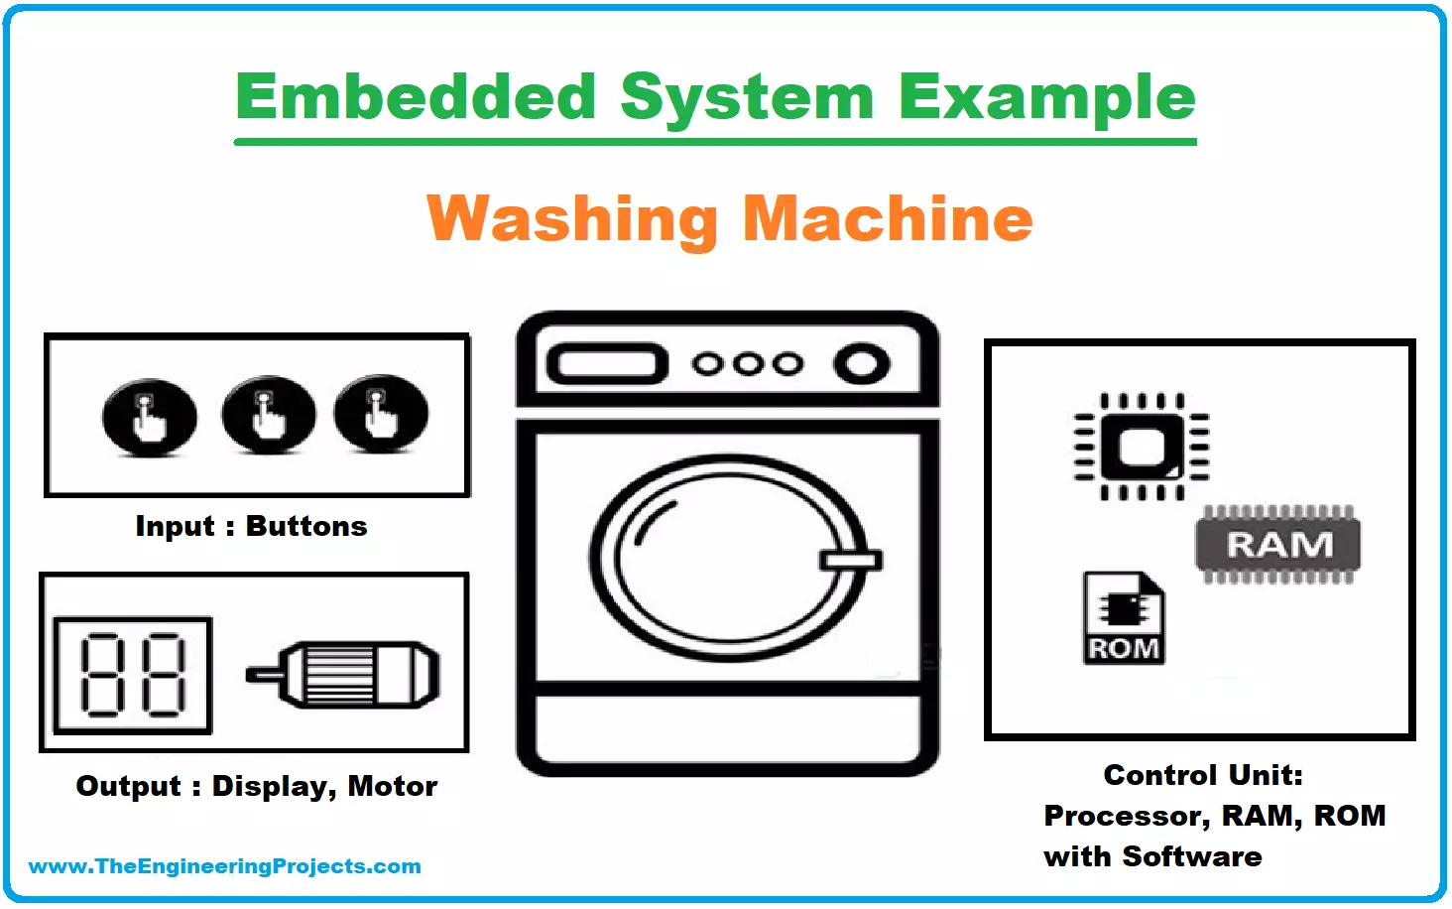
1. Specificity
Embedded systems can either be domain-specific or task-specific.
An embedded system is designated to perform the dedicated task only, it cannot be made to perform several automated functions from different inputs.

Slide 4
2. Strict Design Parameters
There is very little room for extensions and additions in an embedded because we have to fix everything on a single chip

Slide 5
3. Efficiency
An embedded system must be efficient enough to react and respond to the real-time environment.
In certain real-time embedded systems, a system has to react according to the real-time situation and adjust accordingly such as the air conditioner works on the same principle.
The cruise control of a car also works in a real-time response manner by reacting to the real-time situation hence managing the speed and brakes.

Slide 6
5. Exclusive Memory
Embedded systems don't have a secondary memory, their memory is present in embedded system in the form of ROM.
Embedded systems can't have their memories extended or configured, have you thought why?
Let me tell you because they are not general-purpose computers we use normally! They are dedicated systems for special tasks!

Slide 7
6. Multi-Rate Operational System
Some of the large-scale embedded systems are multi-rate operational systems i.e a large number of embedded systems are performing their dedicated functions independently to run a system.
All the multi-rate operational, embedded systems are well articulated to work synchronously with each other.
A car is such an example, many embedded systems work independently to keep a car on road.

Slide 8
7. Compact Design
An embedded system is designed to compact and lightweight as everything is to be placed on a single chip to perform a task including the microcontroller, timer, I/O parts, and the embedded software as well.

Slide 9
8. Minimal Power Dissipation
Embedded systems are designed in such a way to dissipate power at its minimal.
The goal is to conserve power and prevent overheating of the system by adding in heat sinks and cooling fans.

Slide 10
9. Sophisticated Functionality
Embedded systems are highly advanced and developed these days, we are aware of the sophisticated functionalities of mobile phones and tablets.
They are designed to perfection keeping in view the needs and demands of the consumer market!

Slide 11
10. Minimal User Interface
Have a brief look at your air conditioner, your oven, or your washing machine, you might have noticed one thing in common, a minimal user interface.
Embedded systems are designed with minimal user interface because users have almost nothing to do by themselves, you only have to provide the input or we can say instructions, the system is already fully automated to perform the designated task accordingly!
A fully automatic washing machine works on its own after the programme is set and stops once the task is over

Slide 12
11. Safety Factor
A safety analysis is always necessarily carried out for the embedded systems to ensure the safety of the operator and the environment in case of any material damage or hazardous emissions from the system.

Slide 13
12. Cost-Effective
An embedded system is designed in such a way to make it cost-effective, overall the circuit is small since everything is present on a single chip.
A compact design and designated functionality make an embedded system less costly and high speed.

Slide 14
Summary
Requires real time performance
It should have high availability and reliability.
Developed around a real-time operating system
Usually, have easy and a diskless operation, ROM boot
Designed for one specific task
It must be connected with peripherals to connect input and output devices.
Needed minimal user interface
Limited memory, low cost, fewer power consumptions
It does not need any secondary memory in computer.

